Slide 1
Machine Learning

Slide 2
Introduction to Machine Learning

Slide 3
By the end of this lesson, the consultants are expected to know:
1.What is Machine learning?
2.What are the different types of Machine learning?
3.Describe different ML algorithms in detail
4.Build ML models in Jupyter notebook

Slide 4
Introduction
Machine Learning is a subset of AI which focuses mainly in the designing of the system which allows the machines to learn and make predictions by inferring knowledge from data.
Machines combine algorithm and dataset to create models.
The end result of ML is a model that should:
Be able to take an input
Be able to return an output
Outputs doesn’t necessarily have to be numbers

Slide 5

Steps involved in machine learning
Following are the steps that would be necessarily present in any machine learning process.

Slide 6
AI/Machine learning/Deep learning
AI – It is a technique that is especially designed to enable the machines mimic human behaviour
Eg. Robots
ML- It uses statistical techniques to enable machines to improve performance with experience
Eg.Product recommendations
Deep Learning- Subset of ML which makes the computation of multi-layer neural network feasible.
Eg.Automated driving

Slide 7
Real world ML problem
Machine learning algorithms are chosen after analysing the following conditions.
(1) What is the nature of the task?
Identify whether it is Prediction or Inference
(2) Does the data contain labelled or unlabelled data?
When you have labelled data, you need to do supervised learning.
When you don’t, use unsupervised learning.
In supervised learning, if you have continuous data, you should use regression otherwise use classification.

Slide 8
Real world ML problem (contd)
If you want to group the data according to different traits which are present in the dataset, then you should use unsupervised learning.
If it is an autonomy kind of task, you should use reinforcement learning.
If you can spend lots of time in doing the cleaning process and do the training set as a large data, in that case you can go for deep learning.
Also, if you want the results to be more accurate, then you need to go for deep learning.

Slide 9
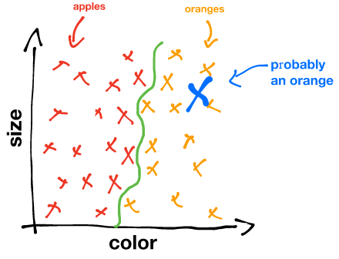
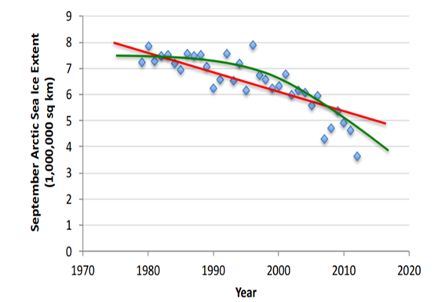
Types of Learning - Supervised
If the dataset is with desired/’correct’ output labels, supervised learning should be used.
Examples: Classification, Linear regression

Slide 10
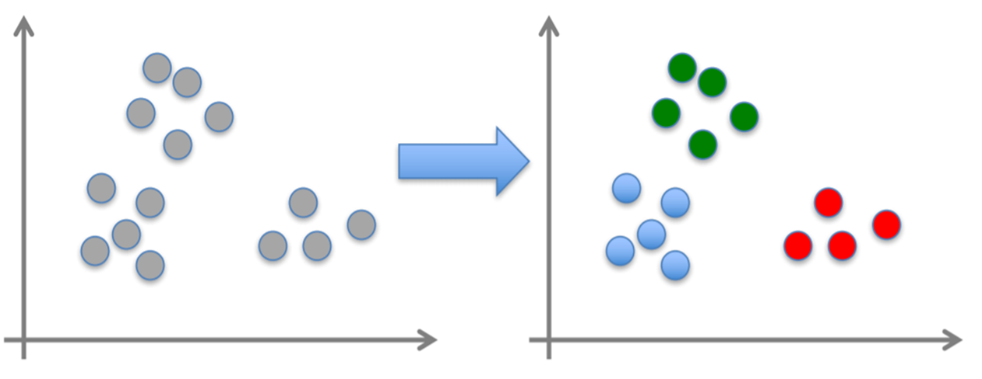
Types of Learning - Unsupervised
When the dataset is without desired output labels, you would use unsupervised learning.
Example: Clustering

Slide 11
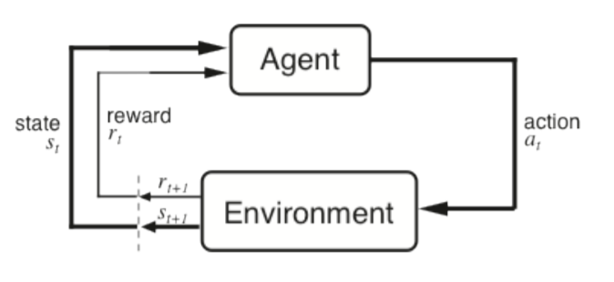
Types of Learning - Reinforcement
Reinforcement learning is a type of dynamic programming that trains algorithms using a system of reward and punishment by interacting with its environment.

Slide 12
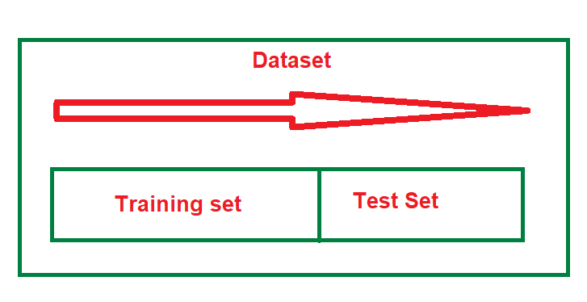
Training and test data
Whenever any dataset is loaded, it will be pre-processed and usually algorithms will split the given data set into two separate ‘test’ and ‘training’ data sets.
Training dataset will be the input to the algorithm to create the ML model.
The accuracy of the model is evaluated through the test dataset.

Slide 13
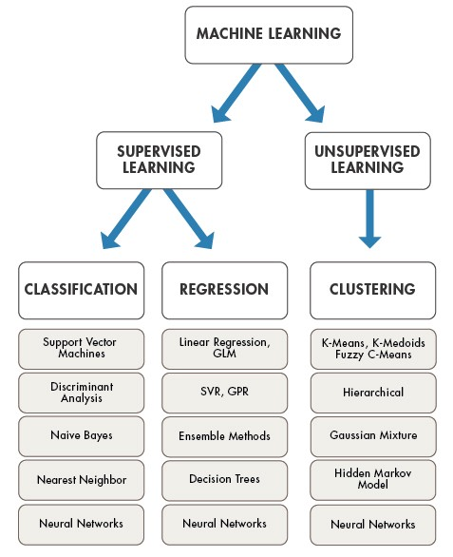
Classification of ML algorithms

Slide 15
Recap
1.What is Machine learning?
2.What are the different types of Machine learning?
From the next slide, we will be covering some of the Machine learning models.

Slide 16
Linear Regression

Slide 17
Introduction
Regression is a predictive modelling technique which is used to find out the relationship between the dependent and the independent variable.
Changes in the y axis with regard to x-axis can be easily explained through regression.
There are two different types of regressions available and they are their usage is as below:
Linear regression- When the dataset contains quantitative variables (Numerical)
Logistic regression – When the dataset contains qualitative variables(String or text)

Slide 18
Introduction(Contd..)
In any regression analysis, you have the dependent variable and an independent variable.
Dependent variable is the main factor that you’re trying to understand or predict.
Eg: Sales
Sales gets increased because of the season, discounts and promotions of any particular product
Independent variables are the factors you suspect have an impact on your dependent variable.
Eg:Promotion
Promotion does not depend on any variable, but y itself would have an impact on the sales.

Slide 19
Applications
Applications where regression is used are:
Identifying the strength of predictors
Eg.What is the effect of marketing on sales
Forecasting an effect of predictors
Eg.Forecasting the impact of change with change in the strength of the predictors.
Analysing the trend
Eg. This is used to predict trends and future values

Slide 20
Linear regression -theory
In simple linear regression we are interested in y = mx+c which is finding the correlation between x and y variable.
Y is a dependent variable and x is an independent variable.
M is the slope and c is the intercept.
This means that every of value of x has a corresponding value of y in it, if it is continuous.
Data is modelled as a straight line and the data is continuous.
Output of the prediction of linear regression is the value of the dependent variable.
Linear regression maps continuous x to continuous y.
Ex: effect of consumer behaviour with the increase of price

Slide 21
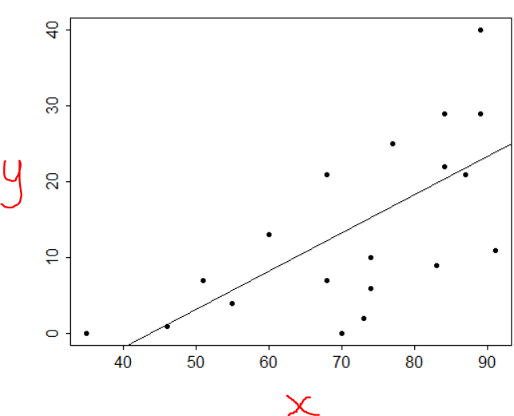
Linear regression-Explanation
Linear regression can be expressed through the following image:
If both x and y variable is increasing then you get a positive straight line.
When x is increasing while y is decreasing then you get a negative slope.
For ex, when you have a defined distance and when the speed is increasing the distance gets decreased and you get a negative slope.so the equation becomes y = -mx+c

Slide 22
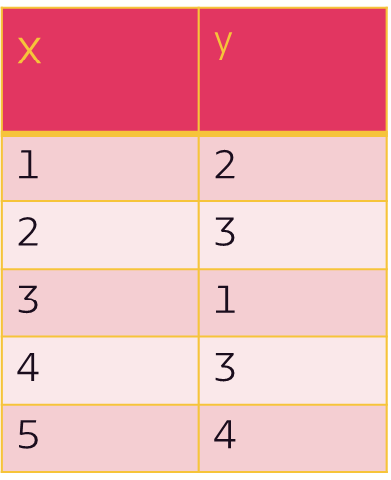
Working of Linear regression
Let us consider the values for two different variables x and y.

Slide 23
Working of Linear regression
After plotting all the values of x and y, you get the following figure:
Next step is to find out the line of best fit.

Slide 24
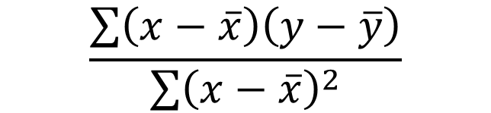
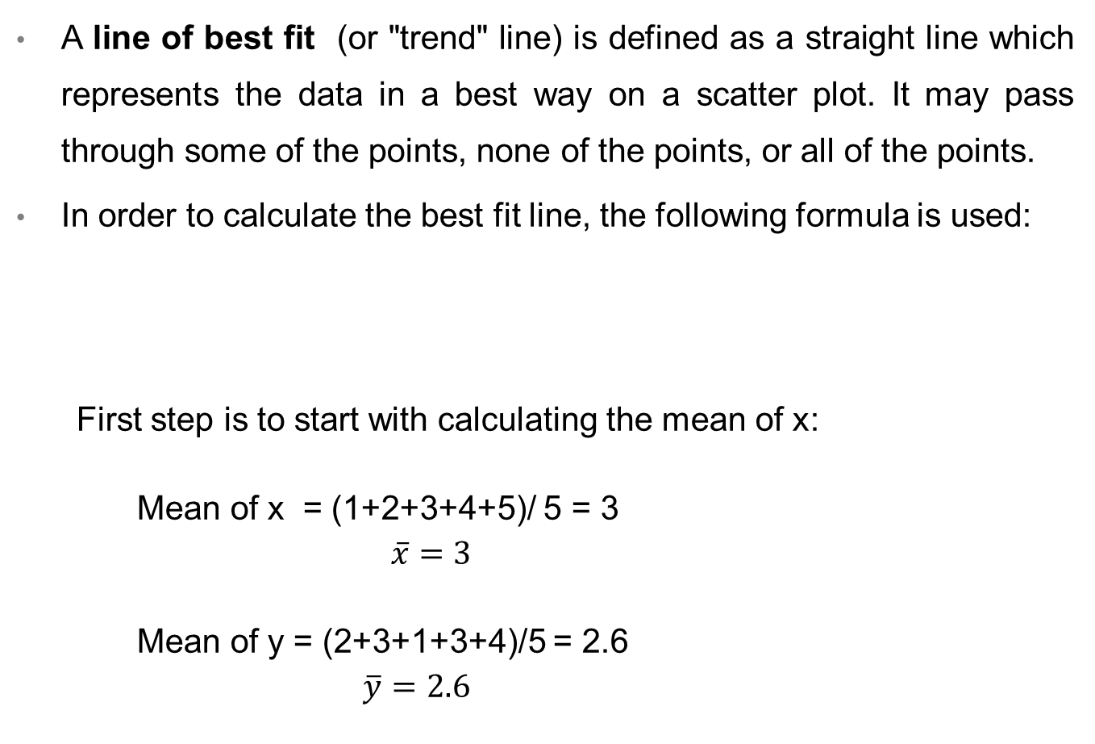
Finding the line of best fit
A line of best fit (or "trend" line) is defined as a straight line which represents the data in a best way on a scatter plot. It may pass through some of the points, none of the points, or all of the points.
In order to calculate the best fit line, the following formula is used:
First step is to start with calculating the mean of x:
Mean of x = (1+2+3+4+5)/ 5 = 3
$\overline{x}=3$
Mean of y = (2+3+1+3+4)/5 = 2.6
$\overline{y}=2.6$
$$\frac{\sum{\left(x−\overline{x}\right)\left(y−\overline{y}\right)}}{\sum{{\left(x−\overline{x}\right)}^{2}}}$$

Slide 25
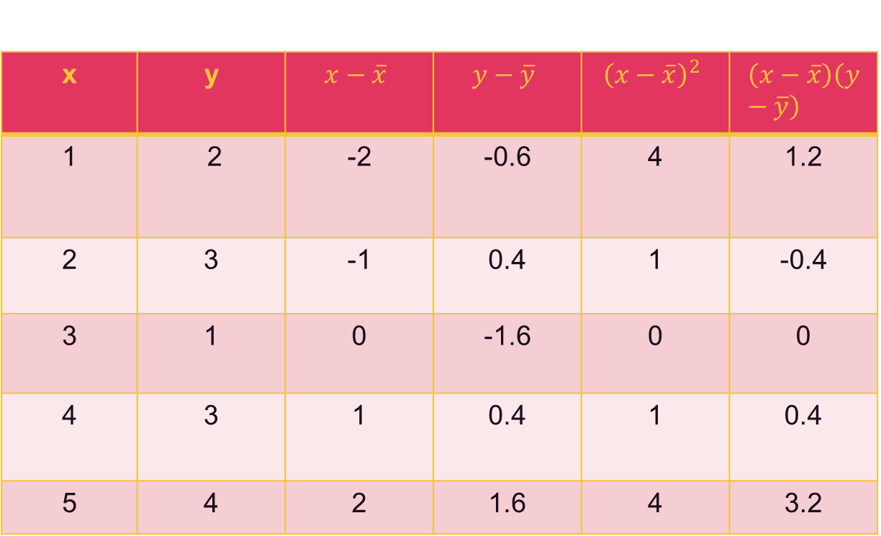
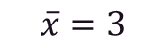
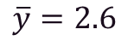
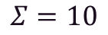
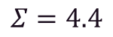
Plugging the value in the above equation,

Slide 26
m = 4.4/10 = 0.44
So now you need to fill in the value in the equation:
y = mx+c
2.6 = 0.44 *3 + C
2.6 = 1.32 + C
C = 2.6 -1.32
C = 1.28
Substituting the value of c in the equation:
y = 0.44x +1.28

Slide 27
Now for all the values of x find out the value of y:
(x=1) y = 0.44 +1.28 = 1.72
(x=2) y = 0.44*2 +1.28 = 2.16
(x=3) y = 0.44*3 + 1.28 = 2.6
(x=4) y = 0.44*4 + 1.28 = 3.04
(x=5) y = 0.44*5 + 1.28 = 3.48
Plotting all the values in the graph will give the regression line.

Slide 28
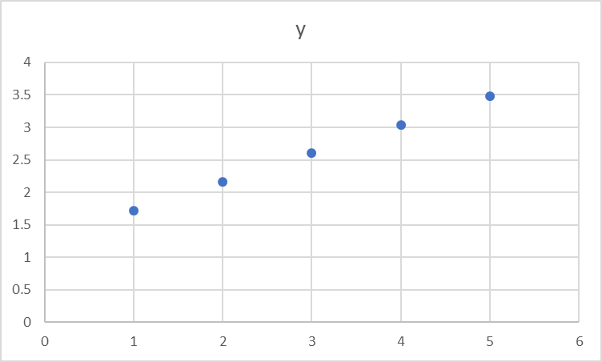
You would arrive with a regression line similar to the one below:
Calculation of mean square error is done by calculating the distance between the actual and predicted value and reduce the distance.
The line with the least error will be the line of linear regression and it will also be the best fit line.

Slide 30
Recap
1.What is linear regression?
2.Working of linear regression
Let’s have some hands-on in Jupyter notebook to build a linear regression model.

Slide 31
Decision trees

Slide 32
Introduction
Lets suppose you want to buy a car.
You would be looking into various factors like the model, year, capacity, colour, number of air bags and finally the price.
You would be checking condition after condition and finally arrive at a decision and that’s exactly how the decision tree works.
Whenever you check for any condition, you arrive at an output in
one or two levels.
Decision tree is a type of classification under supervised model in machine learning where it checks the conditions and provide output accordingly.

Slide 33
What is a decision tree?
Decision tree is a tree shaped representation of the course of actions or outcomes from different conditions.
Each and every branch of the tree is used to represent any possible decision or output.
The starting node of the tree is called the root node, whereas the nodes with the outputs with the decision or outputs are called as leaf nodes.

Slide 34
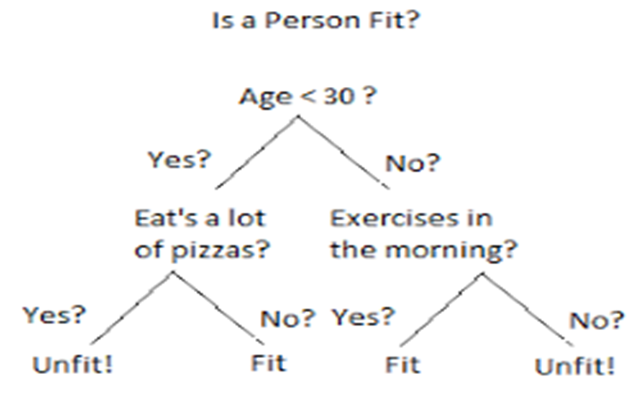
Decision tree-Example
Following example depicts the usage of decision trees.
Image:medium

Slide 35
Applications of Decision trees
Decision trees can be used to solve classification and regression problems.
In classification, given a set of features, you could use decision trees to split into different categories.
Similarly, in regression you can make use of them to predict the future values given a set of values and certain conditions.

Slide 36
Advantages
Decision trees are simple to understand by anybody, interpret and analyse the results.
Very less amount of data preparation is required.
It can be used for categorical and continuous variables.
Non-linear parameters do not affect its performance.

Slide 37
Disadvantages of decision tree
There is a possibility of having overfitting of data.
Even a for a small variation in data, the model may become unstable.
Because of the low-bias in the highly complicated trees, it becomes very difficult to work with the new data.

Slide 38

Terminologies
Entropy : It is a measure of randomness or disorder in the sample.
For example, if it has got diverse data, then it is said to have high entropy. In the example shown below, as it has got flowers and leaves which are of diverse types, entropy of this particular data would be high.

Slide 39

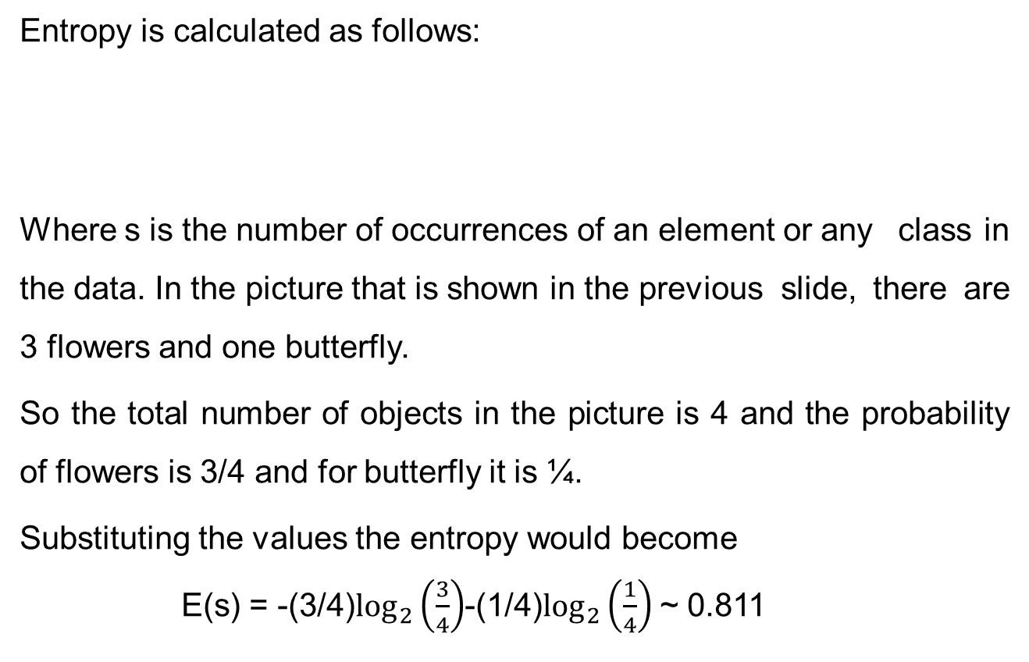
Calculation of entropy
Entropy is calculated as follows:
Where s is the number of occurrences of an element or any class in the data. In the picture that is shown in the previous slide, there are 3 flowers and one butterfly.
So the total number of objects in the picture is 4 and the probability of flowers is 3/4 and for butterfly it is ¼.
Substituting the values the entropy would become
E(s) = -(3/4)$\log_{2}\left(\frac{3}{4}\right)$-(1/4)$\log_{2}\left(\frac{1}{4}\right)$ ~ 0.811

Slide 40
Information gain:
Information gain is a measure to find out how much “information” a feature would give about the class and is calculated as follows:
Information gain = entropy(parent) – [weighted average] * entropy(children)
Each feature would be considered as the parent node and entropy would be calculated for it from which information gain could be calculated.
Process is repeated for all the features and information gain would be calculated using the above formula.
Feature with the highest information gain would become the parent node.

Slide 42
Recap
1.What is a decision tree?
2.Working of entropy and information gain.
Let’s have some hands-on in Jupyter notebook to build a decision tree.

Slide 43
Logistic Regression

Slide 44
Introduction
Logistic regression model is one of the most widely used classification method for common problems which includes binary classifications.
Whenever you want to categorise into positive/negative, yes/no and similar situations, Logistic regression is used.
Important point to note here is, the output of this method is always qualitative and not quantitative.
Approximately 70% of data science problems are classification problems.

Slide 45
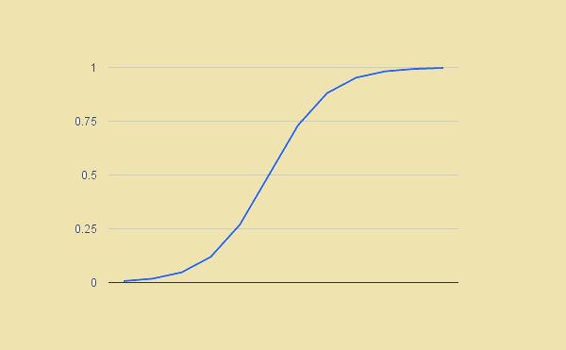
What is Logistic regression?
Logistic regression is a special type of linear regression where the target variable is always a categorical variable.
Logistic Regression makes use of logit function to predict the probability of occurrence of a binary event.

Slide 46
Advantages
Logistic regression is very much efficient and it is straightforward.
High computation power is not needed.
Just because the process is straight forward, it is easy to implement with any kind of dataset.
Anyone who goes through the coding would be able to understand the intricacies.
Because of its simplicity in nature, it is being widely used by data analysts and data scientists.
All the features in the dataset doesn't require scaling of features.
Logistic regression provides a probability score for observations.

Slide 47
Disadvantages
Logistic regression cannot handle large number of features.
It cannot solve non-linear problem and if there is any need, non-linear variables are to be transformed.
Logistic regression will not perform well with the independent variable if they are not correlated with the target variable.
Just because of its categorical nature of the outputs, accuracy of prediction is questionable.
Logistic regression would be overfit which means that it exaggerates the accuracy of its predictions.

Slide 48
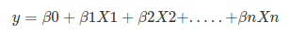
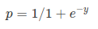
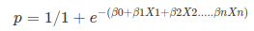
Calculating logistic regression
Normally linear equation is calculated as follows:
Where y is a dependent or target variable and X1,x2,….Xn are the independent variables.
Sigmoid function:
Logistic regression is calculated by adding sigmoid function to the
Linear regression equation and it is as follow:

Slide 49
Terminologies
Maximum likelihood method(MLE) is used for estimation in Logistic regression. In order to produce the observed data, maximizing the likelihood function determines the most likely parameters.
Sigmoid function is a S-shaped curve that can take any real-valued number and map it into a value between 0 and 1.
Confusion matrix is a table that is used to find out the performance level of any classification model. Outputs are given in an array from which accurate and inaccurate number of predictions could be found out easily.
Precision and Recall : When a model makes prediction, how often it is correct is given by precision and recall is how often the relevant items are selected from the total number of instances.

Slide 51
Recap
1.What is Logistic regression?
2.What is the difference between Linear and Logistic algorithms?
Let’s have some hands-on in Jupyter notebook to build a Logistic regression model.

Slide 52
Clustering

Slide 53
Introduction
When there are situations like understanding the customers so that marketing could be done in a better way to reach them, you may not be having any specific labels attached with the data.
Only information that could be made available is the type of transactions that the customers make.
Depending on the type of transaction, you can classify them into different categories.
As it does not have any specific label, it comes under unsupervised algorithm.

Slide 54
What is Clustering?
Clustering is an unsupervised learning method, and one of the common technique for statistical data analysis used in many fields.
It assigns observation sets into subsets (called clusters) in such a way that the objects in the same cluster share common traits.
Clustering can be classified as follows:
Hard Clustering: Each point must belong entirely to one cluster. For example, each student is assigned to only one class
Soft Clustering: Each point is assigned a likelihood or probability of belonging to each cluster.
For example, probability of a student choosing to take a certain class

Slide 55
Clustering example
Categorising cancer types (benign or malignant) from the size of the tumour.
Categorising property type (detached, flats, etc.) from the size of the property and its price.
Customer profiling
market segmentation
computer vision
search engines

Slide 56
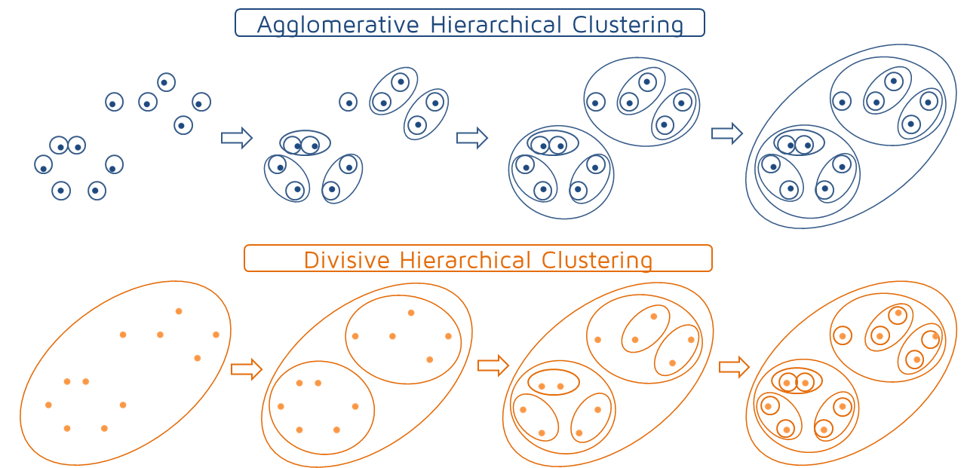
Types of Clustering
There are two different types of clustering that are available.
K-means clustering algorithm aims to partition n observations into k clusters”
Hierarchical clustering involves creating clusters from top to bottom in the predefined order and it is divided into two types which are called as agglomerative(Bottom-up) and divisive(Top-down)
https://towardsdatascience.com/

Slide 57
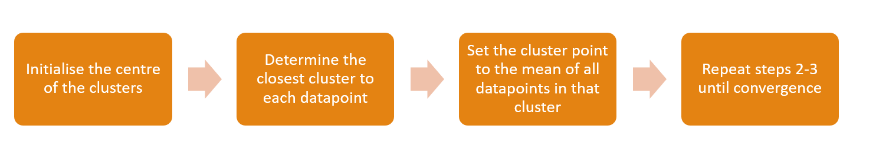
K-Means Clustering process
K-means clustering process can be explained as follows:

Slide 58
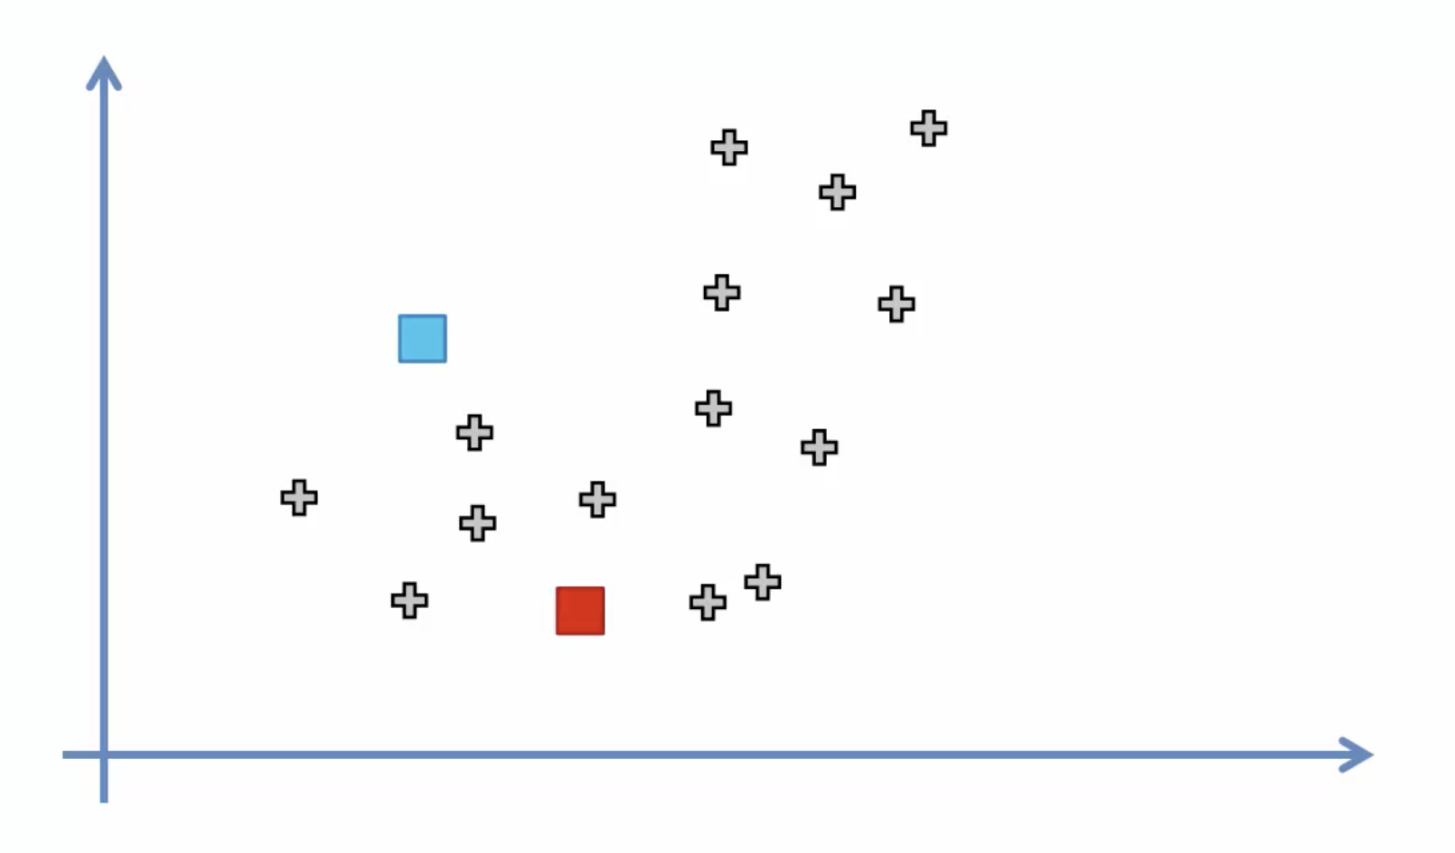
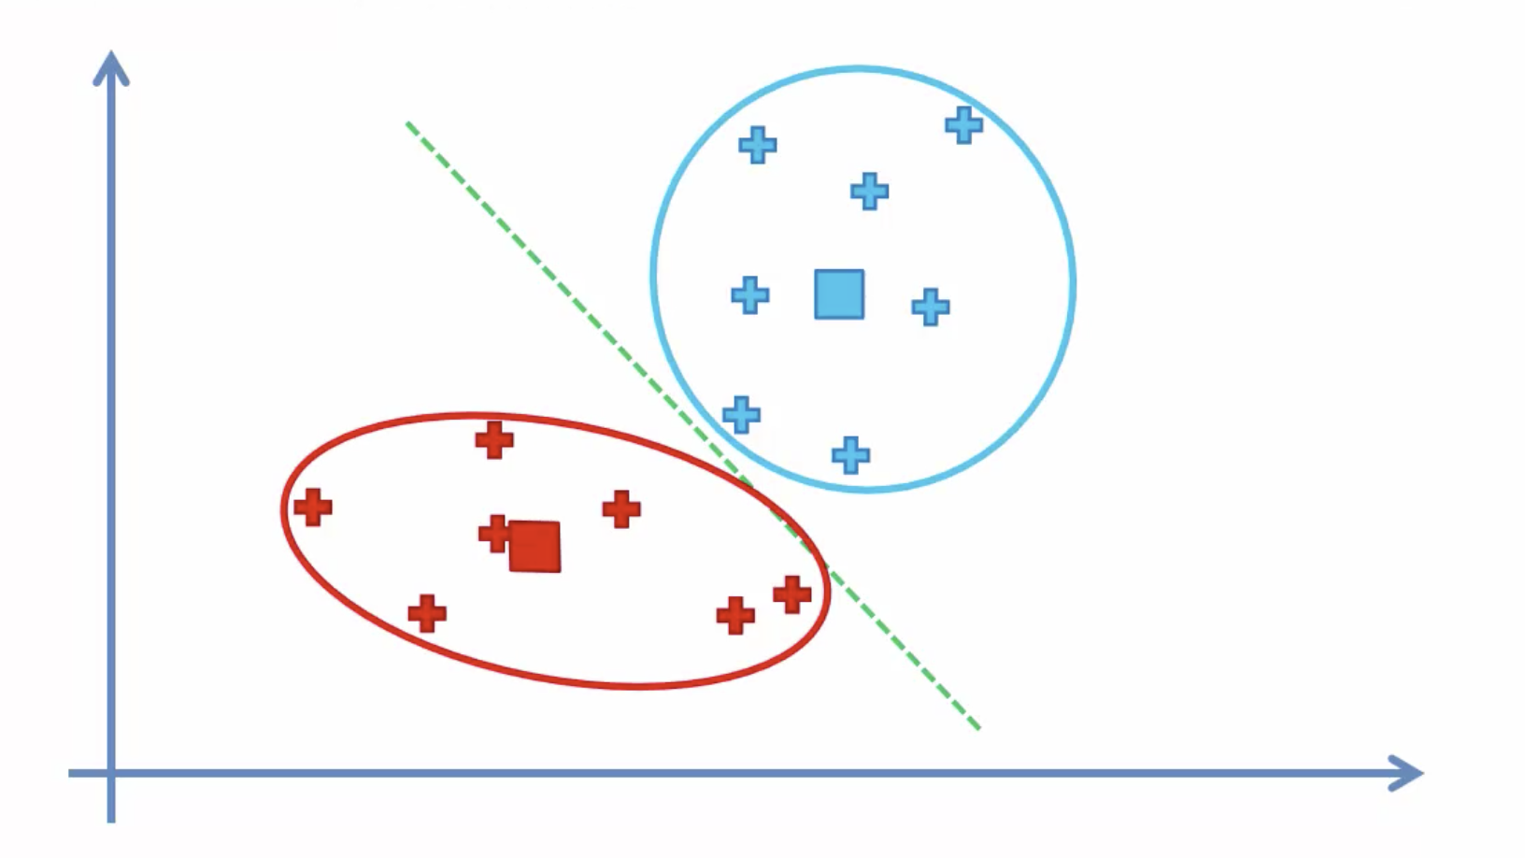
Working of K-means algorithm
K-Means algorithm classifies data without doing the training and testing of data.
After running the algorithm, the groups are defined, and hence any new data can be easily assigned to the most relevant group.

Slide 59
K-Means Clustering : Advantages
1.Easy implementation: K-means is implemented easily to identify unknown groups of data from complex data sets which can be presented in an easy and simple manner as well the results are easy to interpret.
2. Flexibility: K-means algorithm respond to changes easily. Whenever there is any problem, adjusting the cluster segment will allow changes to easily occur on the algorithm.
3. Working with large dataset: K-means is suitable for a large number of datasets and its computational power is much faster.
4. Efficiency: The algorithm used is good at segmenting the large data set. Its efficiency depends on the shape of the clusters.
5.Cost: Compared to using other clustering methods, a k-means clustering technique is fast and efficient in terms of its computational cost O(K*n*d).

Slide 60
K-means Clustering: Disadvantages
1. Optimal set of clusters: K-means doesn’t allow development of an optimal set of clusters and for effective results, you should decide on the cluster before.
2. Lacks consistency: K-means clustering gives varying results on different runs of an algorithm. A random choice of cluster patterns yields different clustering results resulting in inconsistency.
3. Uniform effect: It produces cluster with uniform size even when the input data has different sizes.
4. Order of values: Ordering of the data to build the algorithm affects the final results of the data set.
5. Sensitivity to scale: If you change or rescale the dataset either through normalization or standardization, it will completely change the final results.
6. Nature of data: K-means algorithm accepts only numerical data.
7. Prediction issues: Predicting the k-values before running the algorithm is difficult as you could not be sure what number you need to give for the clusters.

Slide 61
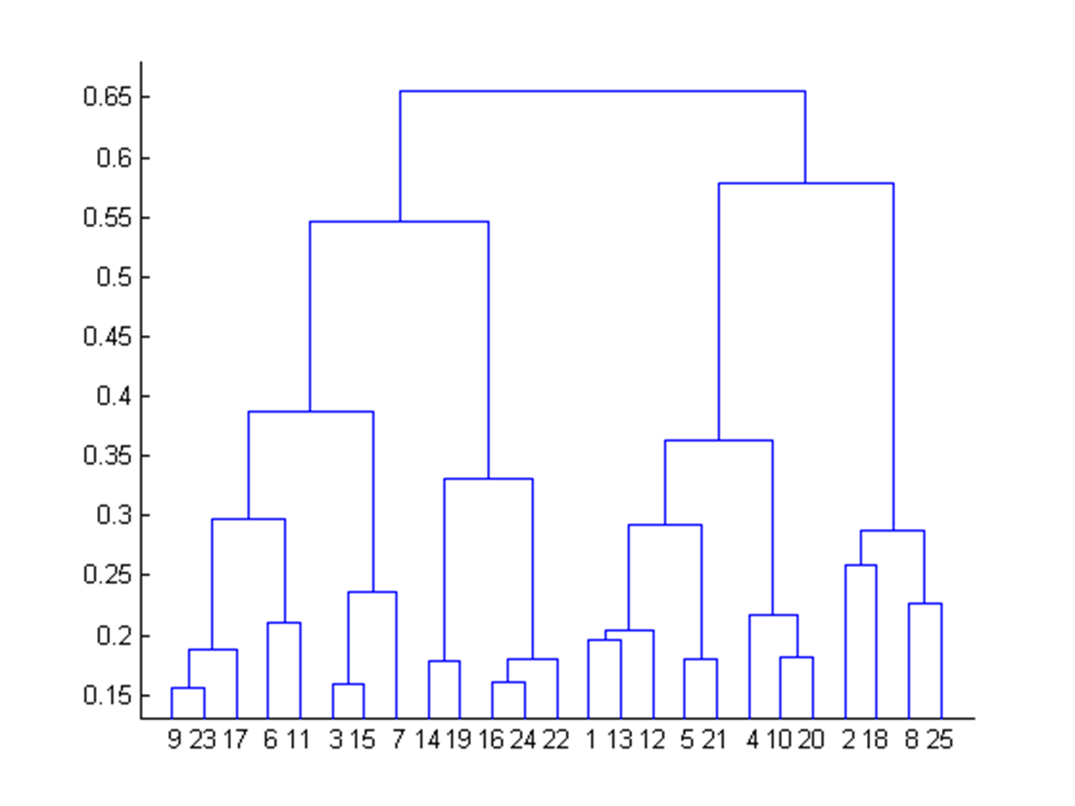
Hierarchical Clustering

Slide 62
Working of Hierarchical Clustering
Hierarchical clusters build hierarchy of and among the clusters.
Two clusters can be merged into the same cluster and this process continues until there is only one cluster left.
It is also possible to drill down until each data point belongs in its own cluster.
Types of Hierarchical clustering are as follows:
Agglomerative: Each data point starts in its own cluster. These are then joined by taking two most similar clusters
Divisive: All data points start in same cluster. Then use methods such as k means to divide into two clusters until you hit number of desired clusters

Slide 63
Hierarchical Clustering-Advantages
Hierarchical clustering outputs a hierarchy, ie a structure that is more informative than the unstructured set of flat clusters returned by k-means.
Therefore, it is easier to decide on the number of clusters by looking at the dendrogram.
Easy to implement.
Can be used for wide variety of data.

Slide 64
Hierarchical Clustering- Disadvantages
After assigning an instance to a cluster, you cannot undo it because of the structures which are built around it.
This could not handle large datasets.
Initial seeds and the order of the data have a strong impact on the final results and it is also very sensitive to outliers
Computation cost is more for larger datasets if you are using Hierarchical clustering.
Even in this algorithm, you would need to assign the number of clusters in advance.

Slide 65
Recap
1.What is Clustering?
2.What are the types of clustering?
3.What are the advantages and disadvantages of k-means clustering?
4. What are the advantages and disadvantages of Hierarchical
clustering?
Let’s try K-means algorithm in Jupyter notebook.

